Slide 1

HamSCI
Meteor Scatter Working Group
Oct 21, 2026
Rob Suggs Ph.D. , NN4NT
NASA Marshall Space Flight Center Amateur Radio Club
and
The HamSCI Community
nn4nt@outlook.com
robert.suggs@scranton.edu
Jay Weitzen Ph.D. , AC1SN
University of Massachusetts - Lowell
and
The HamSCI Community
jay_weitzen@uml.edu
jay.weitzen@scranton.edu

Slide 2
Agenda
Announcements
Action Item Review
Capstone Projects Status – Nathaniel Frissell
MSQP data analysis process – Rob Suggs
Wavelength dependence of scattering efficiency – Rob Suggs
Status of CW beacon testing – Jay Wilson
MIT meteor radar – Ryan Volz/MITLL/Haystack - 21 Oct
Possible tutorials on:
Scattering geometry – Suggs – Nov 4
Sporadic modeling/Meteoroid Engineering Model – Cooke/MEO – Nov 18 ?
CMOR radar – Brown/UWO – Dec 1 ?
Shower modeling – Cooke/MEO – Dec 16 ?
PHARLAP/PyLAP capabilities – Hozumi – Jan 6 ?
Suggestions for future topics ?

Slide 3
Announcements
Michael Hauan has made great progress on Sigmond mods for meteor scatter measurements by PSWS
https://claude.ai/artifact/8PmxugTkZiW8fXZVz3g8aT?sk=QtqYU9mJzvyCjPG7gMoPDw#54ec8c09-d327
  Please review and send comments to the meteor scatter email hamsci-meteors@scranton.edu
Tom McMahan has made progress with the specular ellipsoid tool
We plan to start posting these slide decks to our Sharepoint when it is available

Slide 4
Action Item Review
Number | Actionee | Due Date | Description | Status
1 | Jay Weitzen | 9/23 | Investigate 1 sec Kostas coding (talk to David)
9 | Rob Suggs | 9/30 | Make GitHub doc repository private – remove copyrighted material | McKinley removed – migrate all to Sharepoint? Moved to action 11
10 | Robert Hipple | 10/14 | Report on testing of SIGMOND Meteor Scatter module | Closed 10/14
11 | Rob Suggs | 10/21 | Contact Scranton Tech Support regarding Sharepoint use | Emailed 10/25, waiting to hear. #1160387
12
13
14
15
16
17
18
19
20

Slide 5
Capstone project status

Slide 6
Nascent MSQP data analysis process
Python script to read WAV and plot signal amplitude vs time was used last year
Added capability to read WAV metadata (tag:comment) consisting of frequency, callsign, grid square and to compute range and heading from TX and RX grids
  Found that metadata does not always reflect what WSJT decodes
  Main problem is in the non-CQ messages but others as well
Plan B is to batch decode WAV files with WSJT-X and extract data from ALL.TXT file, when it wasn’t provided, then match the times – see next slide
Will still use Python script to generate plots for quick review and counting of underdense meteors
May add shower radiant az and el at time of decode

Slide 7
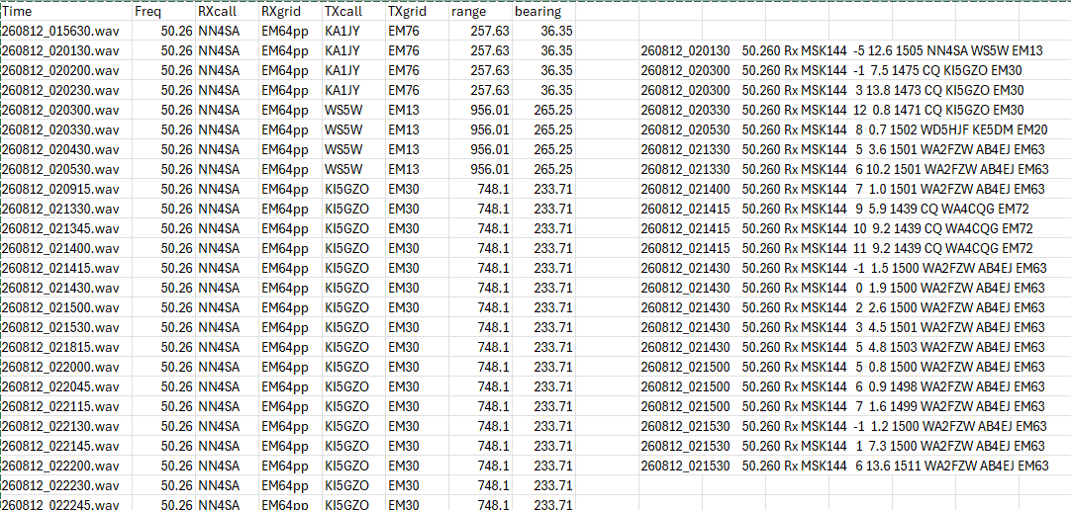
From Suggs’ Python script
using WAV Tag. Agrees with Audacity
From WSJT-X all.txt file after re-decoding WAV files
Can’t trust WAV Tag:comment

Slide 8
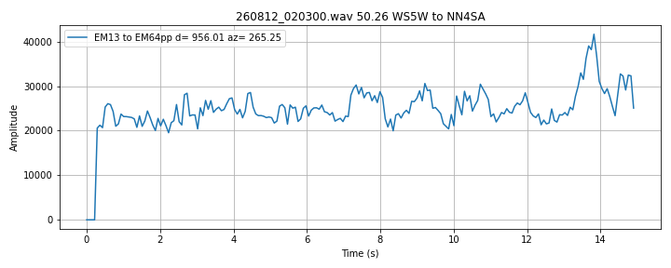
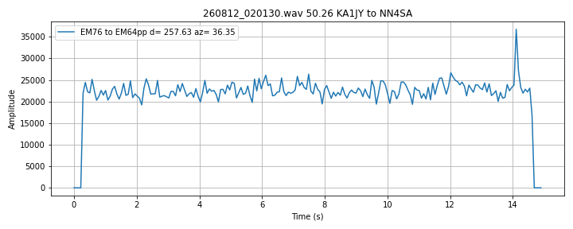
Actually WS5W in EM13

Slide 9
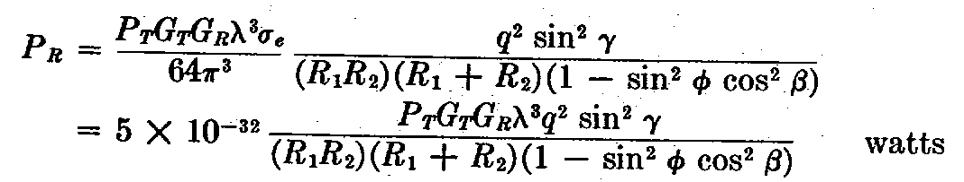
Scattered signal power is a strong function of wavelength
Important point is that the signal strength goes as the cube of the wavelength, λ, and the square of the electron line density, q
You want to use the longest wavelength (lowest frequency) possible.
If you get into HF bands, Ionospheric effects can dominate so lower
VHF (40 – 100 MHz) is best. From McKinley, 1961 eq. 9-3.
So 10m should be preferable to 6m.

Slide 10
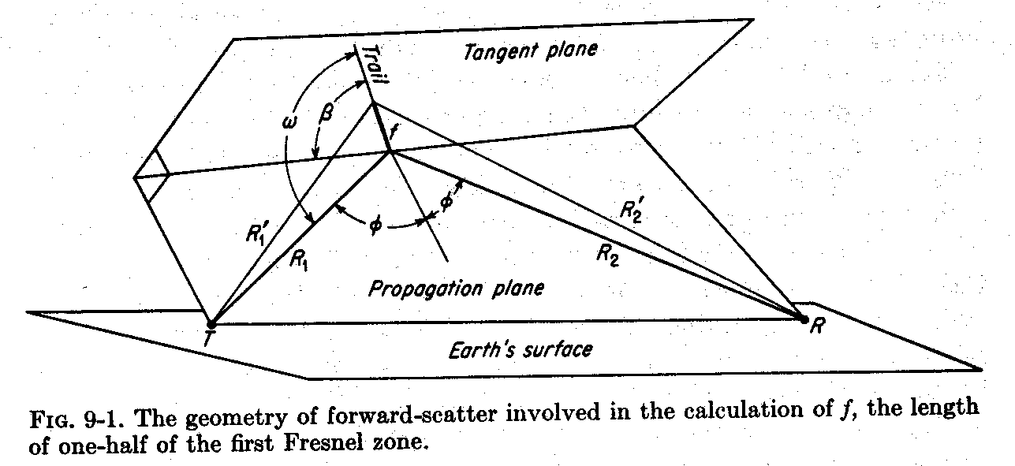
Forward Scatter Geometry
From “Meteor Science and Engineering”, D.W.R. McKinley

Slide 11
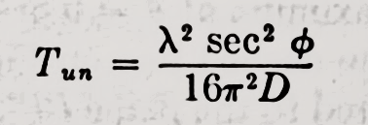
Signal duration is proportional to square of the wavelength
What does D depend on?
D is the electron diffusion coefficient in m²/sec
From “Meteor Science and Engineering”, D.W.R. McKinley

Slide 12
Dependence of strength and duration for various amateur MSK144 frequencies
Frequency MHz | Rel strength | Rel Str dB | Rel duration
144.15 | 0.04 | -13.7 | 0.12
50.26 | 1.00 | 0.0 | 1.00
28.145 | 5.69 | 7.6 | 3.19
Scattered power is proportional to the wavelength³ or 1/frequency³
Signal duration is proportional to wavelength²

Slide 13
Wilson - CW Beacon Testing

Slide 14
Haystack meteor radar - Volz

Slide 15
Backup

Slide 16
Homework – Read/view the following
Weitzen and Ralston MS review paper https://github.com/HamSCI/MSQP/blob/main/Weitzen_and_Ralston_Meteor_scatter_an_overview.pdf
Suggs’ HamSCI talk/slides https://www.hamsci.org/sites/default/files/article/Workshop_2026/Meteor_Scatter_Science_Behind_the_Pings_HamSCI_conference_RevB.pdf
https://www.youtube.com/watch?v=1pgrXqg435g&t=3s
Balis+ – example of what can be done with CW forward scatter
McKinley chapters - contact Rob Suggs for copies
MSK144 Protocol https://github.com/HamSCI/MSQP/blob/main/MSK144_Protocol_QEX.pdf
CMOR radar info https://aquarid.physics.uwo.ca/research/radar/cmor_intro.html

